Slide 1

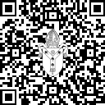
Deanery Roadshows
2025
The next steps to growth …
click.canterburydiocese.org/roadshows2025
Notes:
---
This presentation outlines the agenda for the Deanery Roadshow, detailing the key areas of focus and activities planned. We will cover refreshments, welcoming worship, important notices, mission planning, safeguarding, workshops, good news stories, and the closing activities.

Slide 2

Deanery Roadshows 2025 Agenda
18:45
- Refreshments
19:00
- Welcome
- Worship
- Noticeboard
- Safeguarding
20:00
- Workshops
- Growing Giving and Generosity
- Leading your Church into Growth
- Children, Young People & Education: Welcoming the ‘Quiet Revival’
20:40
- Good news stories
21:00
- Finish
Notes:
The Deanery Roadshows 2025 will kick off with refreshments, followed by a warm welcome and worship session. Important updates will be shared on the noticeboard, particularly about safeguarding. Workshops focusing on growth in giving and education will follow, culminating with uplifting stories from the Deanery and a blessing as we conclude the evening.

Slide 3
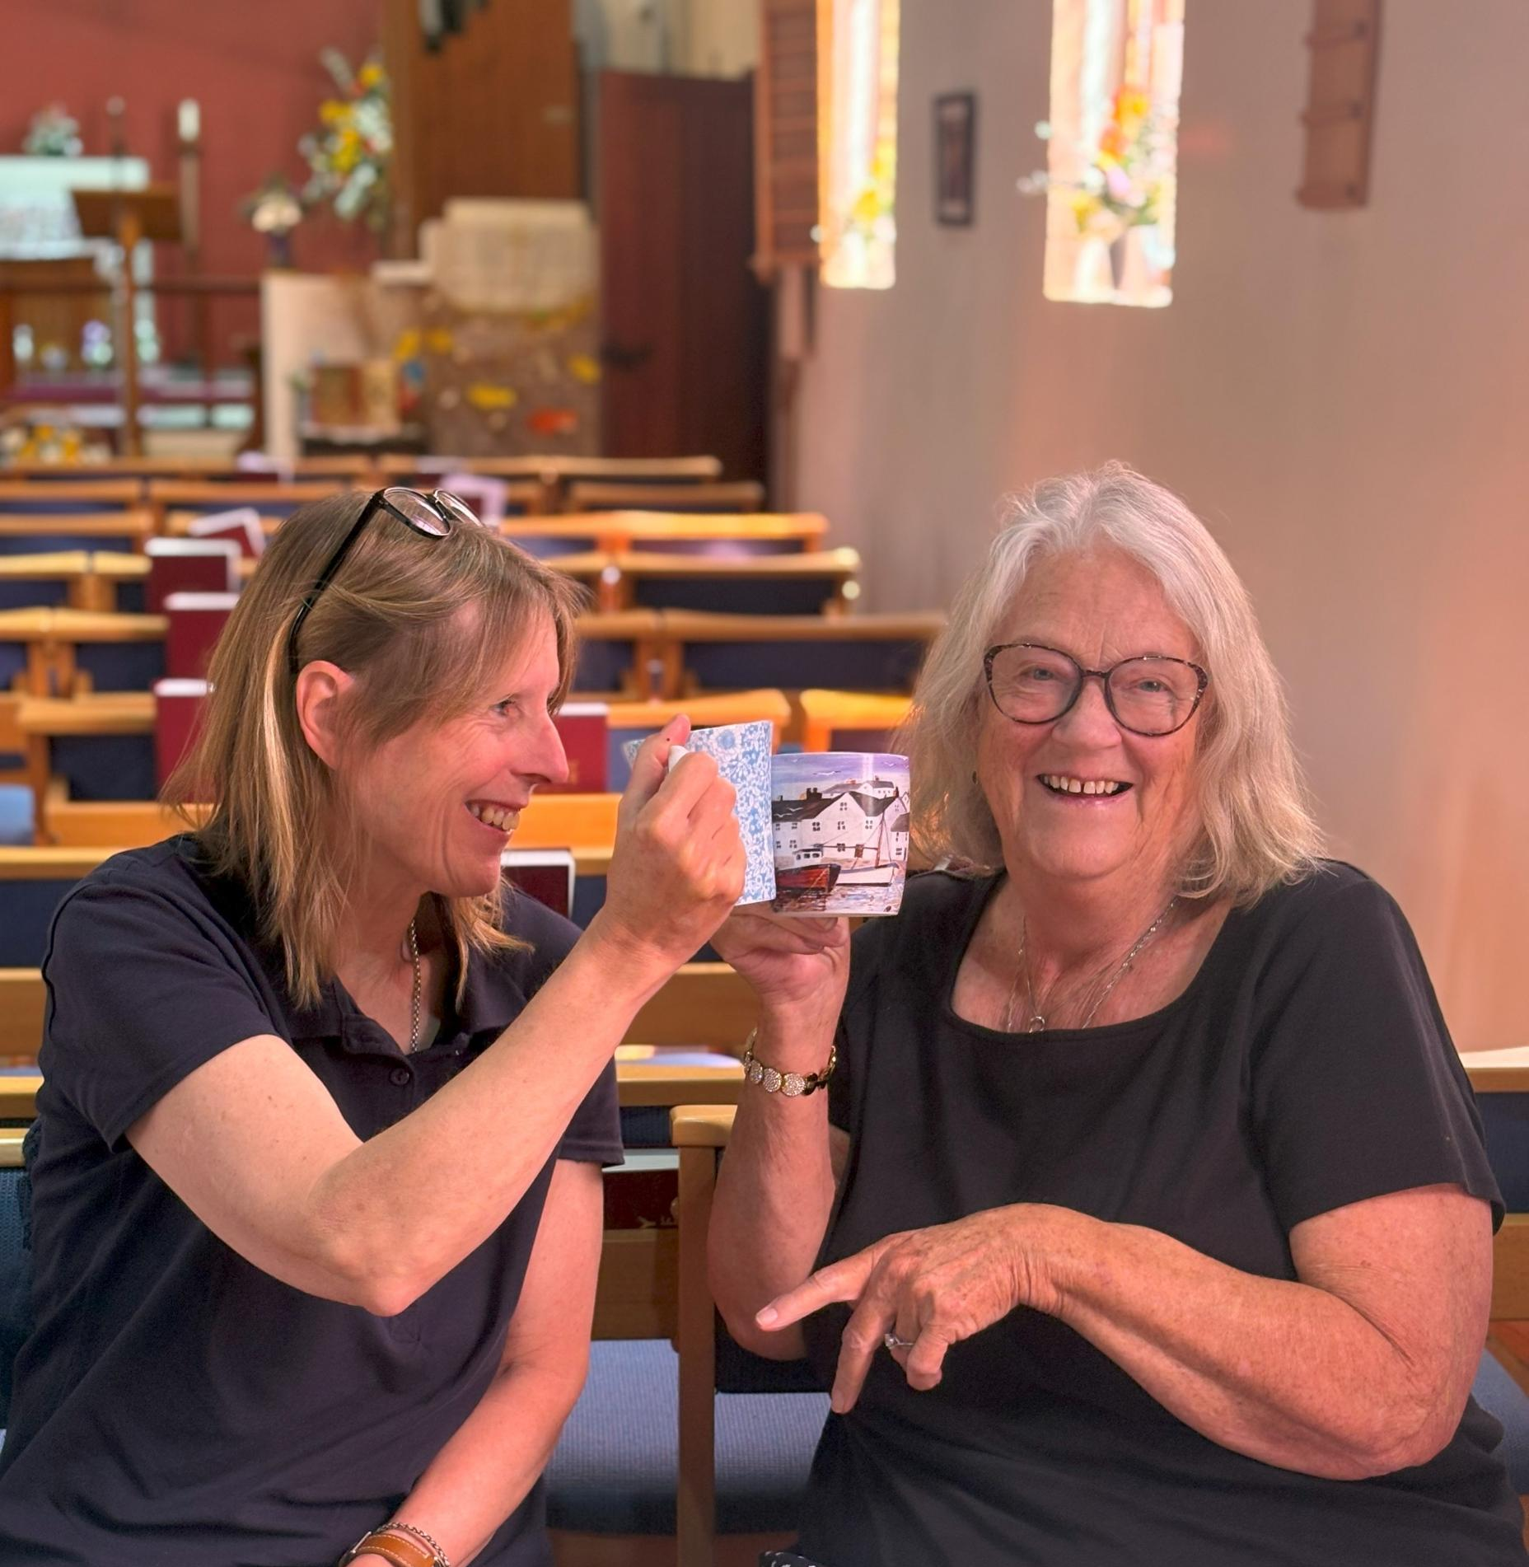
Welcome from Area Dean and Lay Chair
Notes:
In this agenda, we will explore several important sections: Refreshments, Welcome and Worship, Noticeboard Information, Mission Action Planning, Safeguarding, Workshops, Good News Stories, and Closing. Each section will provide specific insights into the activities and discussions planned.

Slide 4
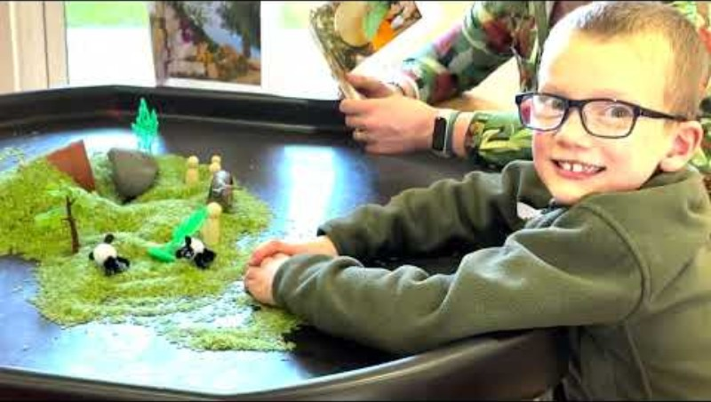

Slide 5
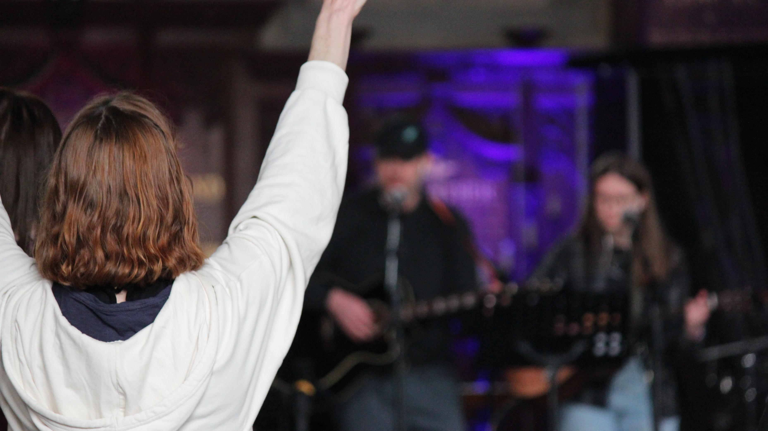
Worship
Notes:
---
This slide references information from the following file: https://canterburydiocesan.sharepoint.com/sites/StrategyBlueprint/_layouts/15/Doc.aspx?sourcedoc=%7BCB9CB7FE-97C2-48FD-BABA-44D0C3403F9F%7D&file=Deanery%20Roadshow%20Agenda%20full.docx&action=default&mobileredirect=true&DefaultItemOpen=1
Welcome by Area Dean and Lay Chair

Slide 6
Finance

Slide 7
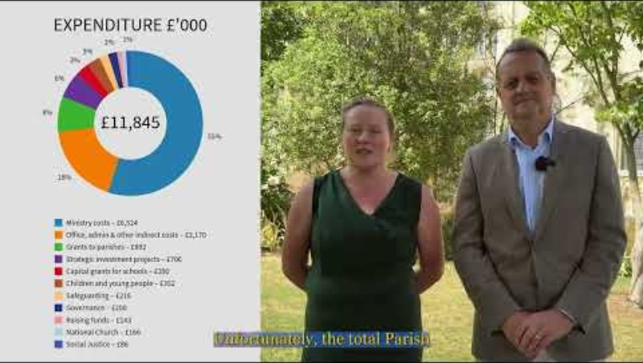
Noticeboards: Finance
Notes:
---
This slide references information from the following file: https://canterburydiocesan.sharepoint.com/sites/StrategyBlueprint/_layouts/15/Doc.aspx?sourcedoc=%7BCB9CB7FE-97C2-48FD-BABA-44D0C3403F9F%7D&file=Deanery%20Roadshow%20Agenda%20full.docx&action=default&mobileredirect=true&DefaultItemOpen=1
Finance video

Slide 8
ACTS435
Notes:
Acts 435 helps you to support people in your parishes in their time of need.
It is cost-neutral and is completely free to sign up and use.
It is quick and easy to set up and manage, with donations being paid directly into your church’s bank account.
It brings people into your church and enables you to offer support in a tangible, practical way.
To sign up, email rtarget@diocant.org – this will enable us to support you in the setup process, and to build a network of Acts 435 advocates in churches across the diocese.

Slide 9

Noticeboards: Acts435
Notes:
Acts 435 helps you to support people in your parishes in their time of need.
It is cost-neutral and is completely free to sign up and use.
It is quick and easy to set up and manage, with donations being paid directly into your church’s bank account.
It brings people into your church and enables you to offer support in a tangible, practical way.
To sign up, email rtarget@diocant.org – this will enable us to support you in the setup process, and to build a network of Acts 435 advocates in churches across the diocese.
---
This slide references information from the following file: https://canterburydiocesan.sharepoint.com/sites/StrategyBlueprint/_layouts/15/Doc.aspx?sourcedoc=%7BCB9CB7FE-97C2-48FD-BABA-44D0C3403F9F%7D&file=Deanery%20Roadshow%20Agenda%20full.docx&action=default&mobileredirect=true&DefaultItemOpen=1
Finance video

Slide 10
Net Zero Carbon

Slide 11
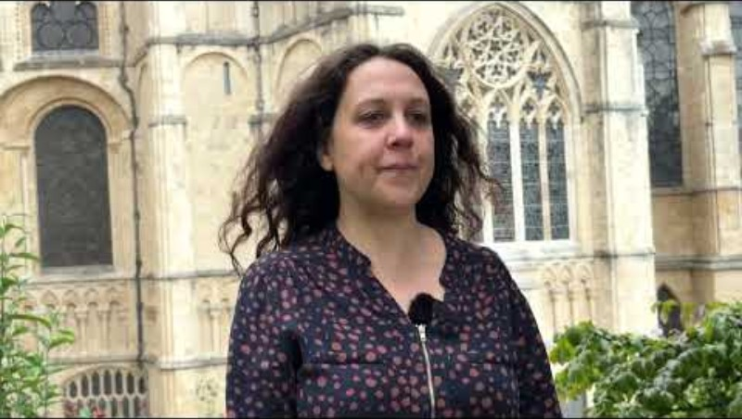
Noticeboards: Net Zero
Notes:
---
This slide references information from the following file: https://canterburydiocesan.sharepoint.com/sites/StrategyBlueprint/_layouts/15/Doc.aspx?sourcedoc=%7BCB9CB7FE-97C2-48FD-BABA-44D0C3403F9F%7D&file=Deanery%20Roadshow%20Agenda%20full.docx&action=default&mobileredirect=true&DefaultItemOpen=1
Finance video

Slide 12
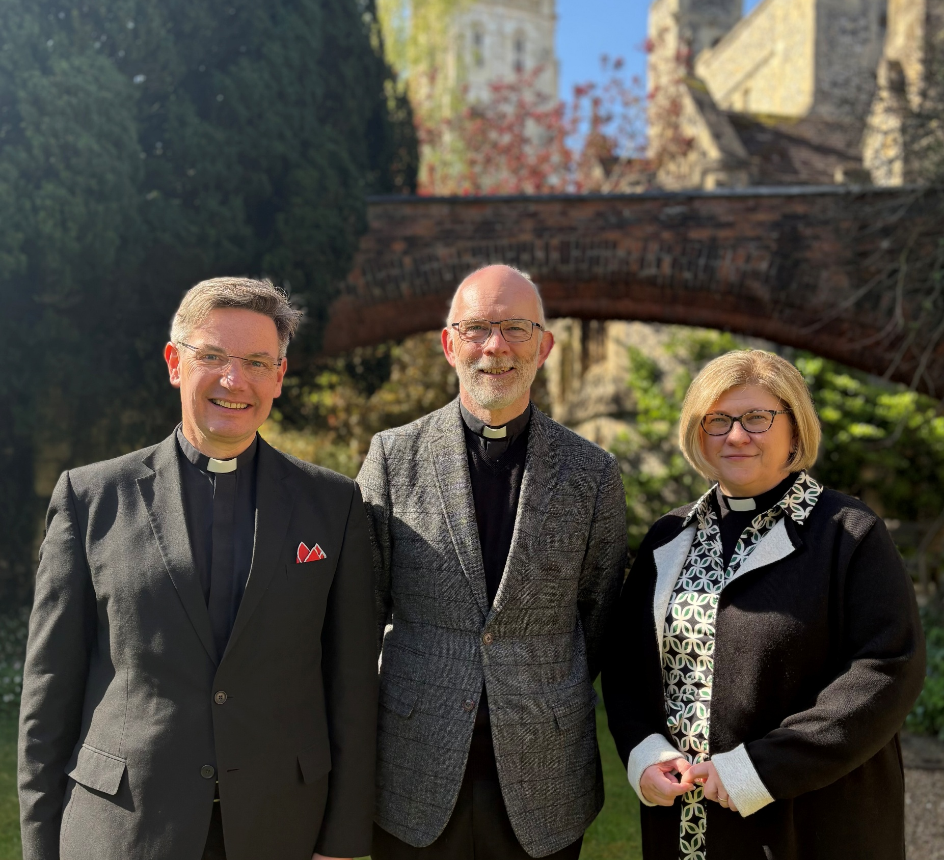
Mission Action Planning (MAP)
Notes:
---
This slide references information from the following file: https://canterburydiocesan.sharepoint.com/sites/StrategyBlueprint/_layouts/15/Doc.aspx?sourcedoc=%7BCB9CB7FE-97C2-48FD-BABA-44D0C3403F9F%7D&file=Deanery%20Roadshow%20Agenda%20full.docx&action=default&mobileredirect=true&DefaultItemOpen=1
19.30 Noticeboard - information and signposting
· Finance (video) – 5 mins
· Acts 435 (video and notice) – 5 mins
· Net Zero Carbon (video) – 5 mins

Slide 13
Safeguarding

Slide 15



Remember why safeguarding is important

Slide 16
National Safeguarding Standards

Slide 17


Helpful tools: Parish Hub and Dashboard

Slide 18
Parish Hubs and Dashboards
Deanery Completion Progress

Slide 19
Helpful Tools

Slide 20
Safeguarding is Everyone’s Responsibility

Slide 21
Workshops
Children, Young People and Education: Welcoming the ‘Quiet Revival’
Growing Giving and Generosity
Leading your church into growth
Notes:
---
This slide references information from the following file: https://canterburydiocesan.sharepoint.com/sites/StrategyBlueprint/_layouts/15/Doc.aspx?sourcedoc=%7BCB9CB7FE-97C2-48FD-BABA-44D0C3403F9F%7D&file=Deanery%20Roadshow%20Agenda%20full.docx&action=default&mobileredirect=true&DefaultItemOpen=1
Generous Giving & Parish Support

Slide 22
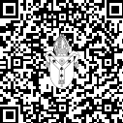

Good news stories
Sign up to our Media and Engagement Deanery Drop-Ins:
click.canterburydiocese.org/MandE-Deanery-Drop-Ins
Notes:
---
This slide references information from the following file: https://canterburydiocesan.sharepoint.com/sites/StrategyBlueprint/_layouts/15/Doc.aspx?sourcedoc=%7BCB9CB7FE-97C2-48FD-BABA-44D0C3403F9F%7D&file=Deanery%20Roadshow%20Agenda%20full.docx&action=default&mobileredirect=true&DefaultItemOpen=1
Generous Giving & Parish Support

Slide 23
Access roadshow resources
click.canterburydiocese.org/roadshows2025
Notes:
---
This slide references information from the following file: https://canterburydiocesan.sharepoint.com/sites/StrategyBlueprint/_layouts/15/Doc.aspx?sourcedoc=%7BCB9CB7FE-97C2-48FD-BABA-44D0C3403F9F%7D&file=Deanery%20Roadshow%20Agenda%20full.docx&action=default&mobileredirect=true&DefaultItemOpen=1
Generous Giving & Parish Support

