Slide 1
Deanery Roadshows 2025
The next steps to growth …
Notes:
AI-generated content may be incorrect. --- This presentation outlines the agenda for the Deanery Roadshow, detailing the key areas of focus and activities planned. We will cover refreshments, welcoming worship, important notices, mission planning, safeguarding, workshops, good news stories, and the closing activities.

Slide 2
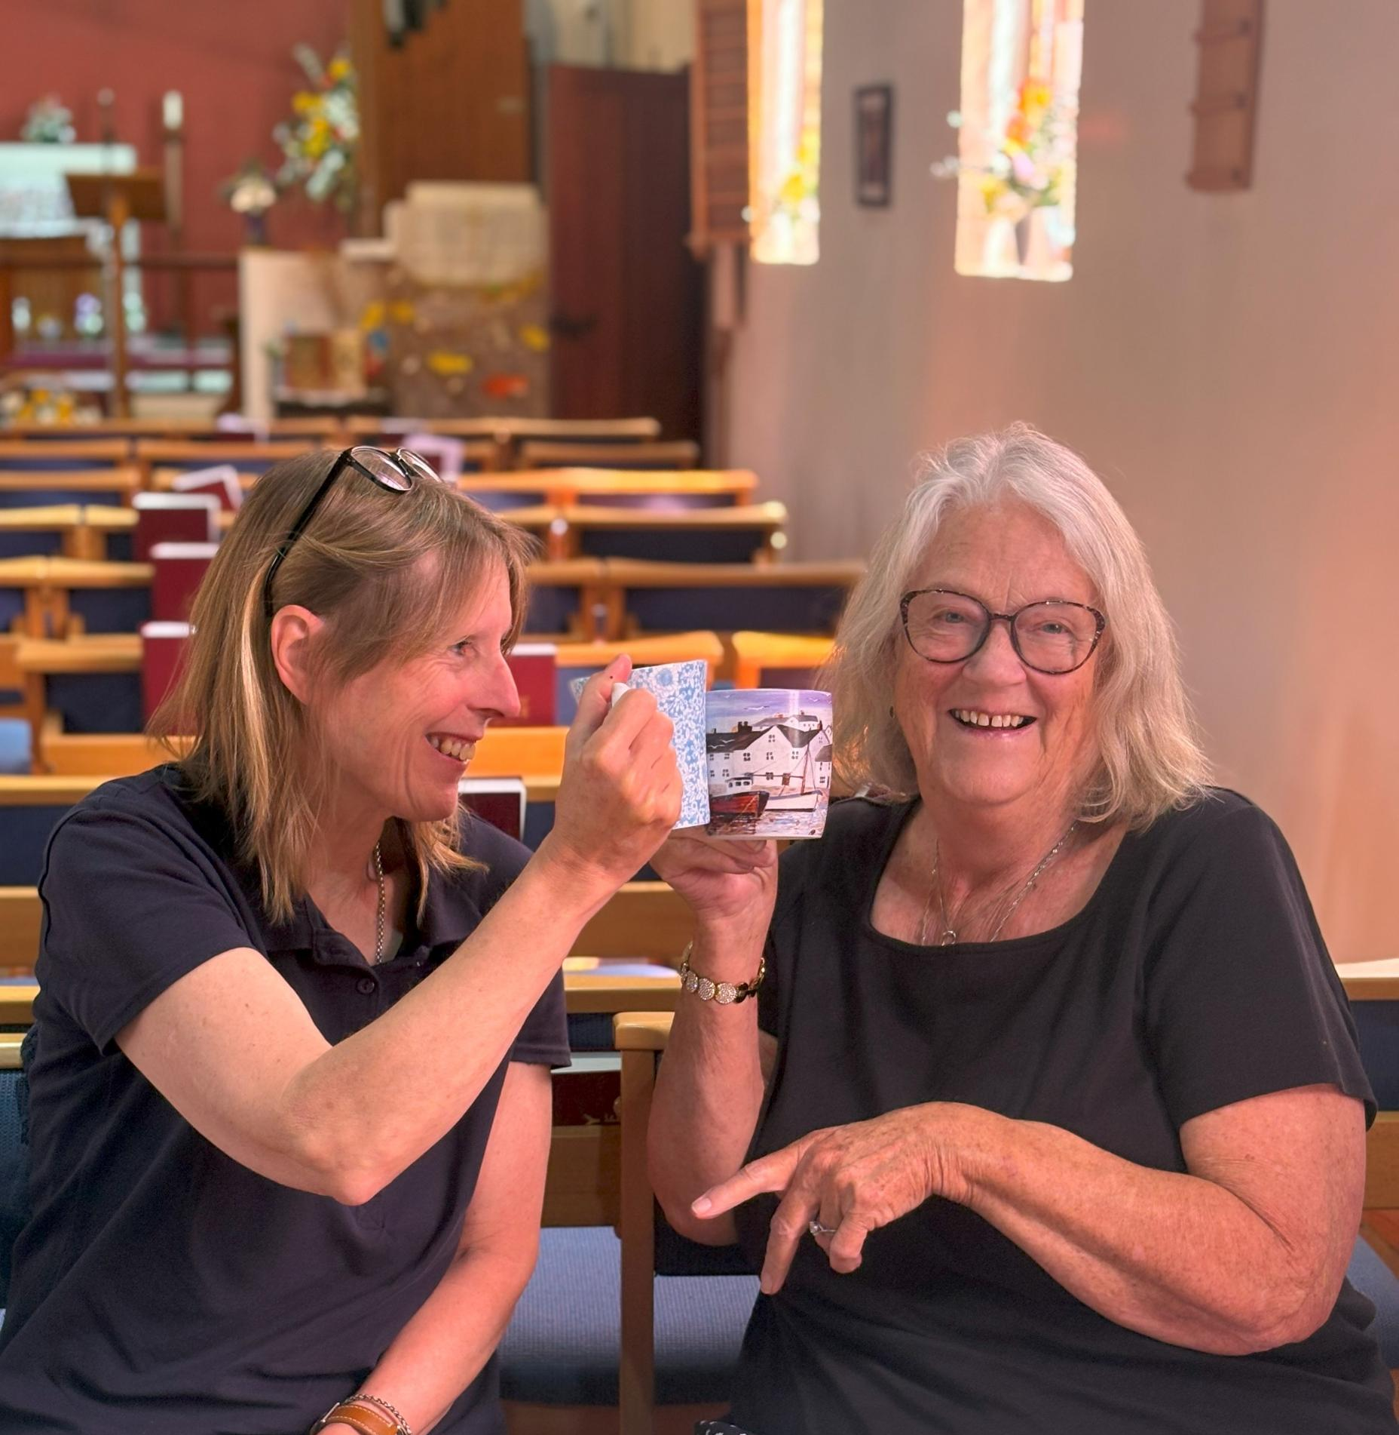
Welcome from Area Dean and Lay Chair
Notes:
In this agenda, we will explore several important sections: Refreshments, Welcome and Worship, Noticeboard Information, Mission Action Planning, Safeguarding, Workshops, Good News Stories, and Closing. Each section will provide specific insights into the activities and discussions planned.

Slide 4
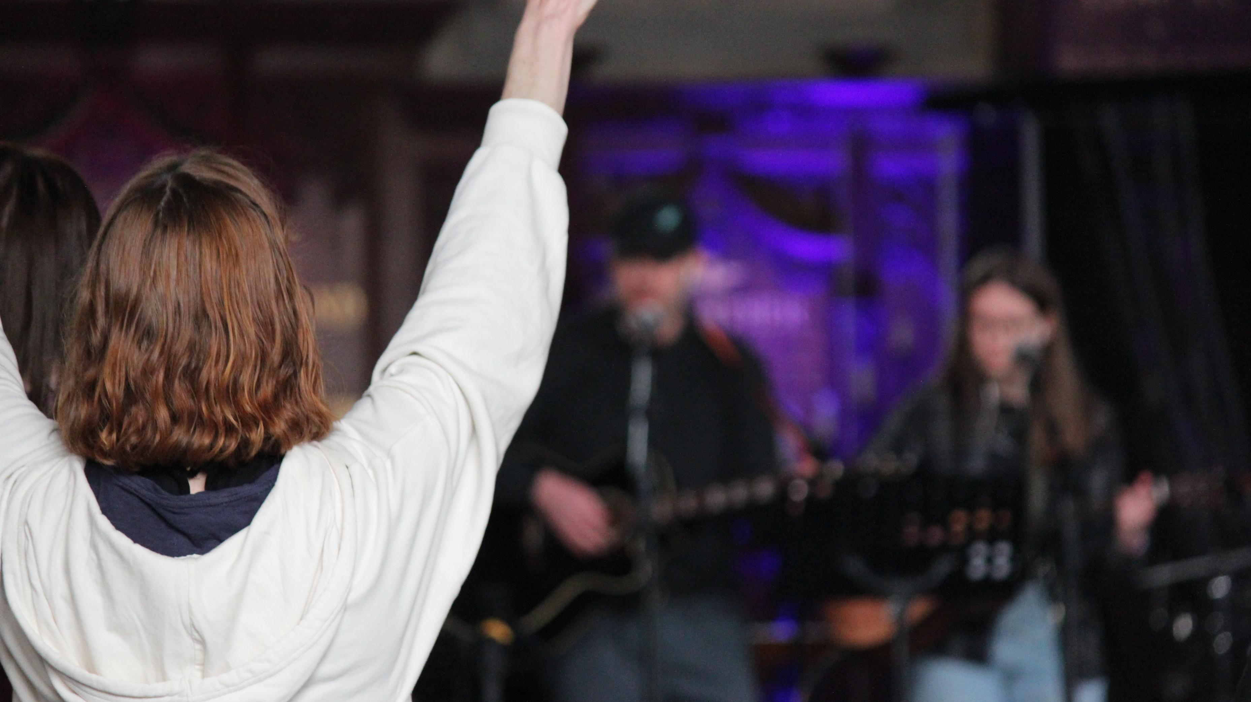
Worship
Notes:
--- This slide references information from the following file: https://canterburydiocesan.sharepoint.com/sites/StrategyBlueprint/_layouts/15/Doc.aspx?sourcedoc=%7BCB9CB7FE-97C2-48FD-BABA-44D0C3403F9F%7D&file=Deanery%20Roadshow%20Agenda%20full.docx&action=default&mobileredirect=true&DefaultItemOpen=1 Welcome by Area Dean and Lay Chair

Slide 5
Finance

Slide 6
ACTS435
Notes:
Acts 435 helps you to support people in your parishes in their time of need.
It is cost-neutral and is completely free to sign up and use.
It is quick and easy to set up and manage, with donations being paid directly into your church’s bank account.
It brings people into your church and enables you to offer support in a tangible, practical way.
To sign up, email rtarget@diocant.org – this will enable us to support you in the setup process, and to build a network of Acts 435 advocates in churches across the diocese.

Slide 7
Net Nero

Slide 8
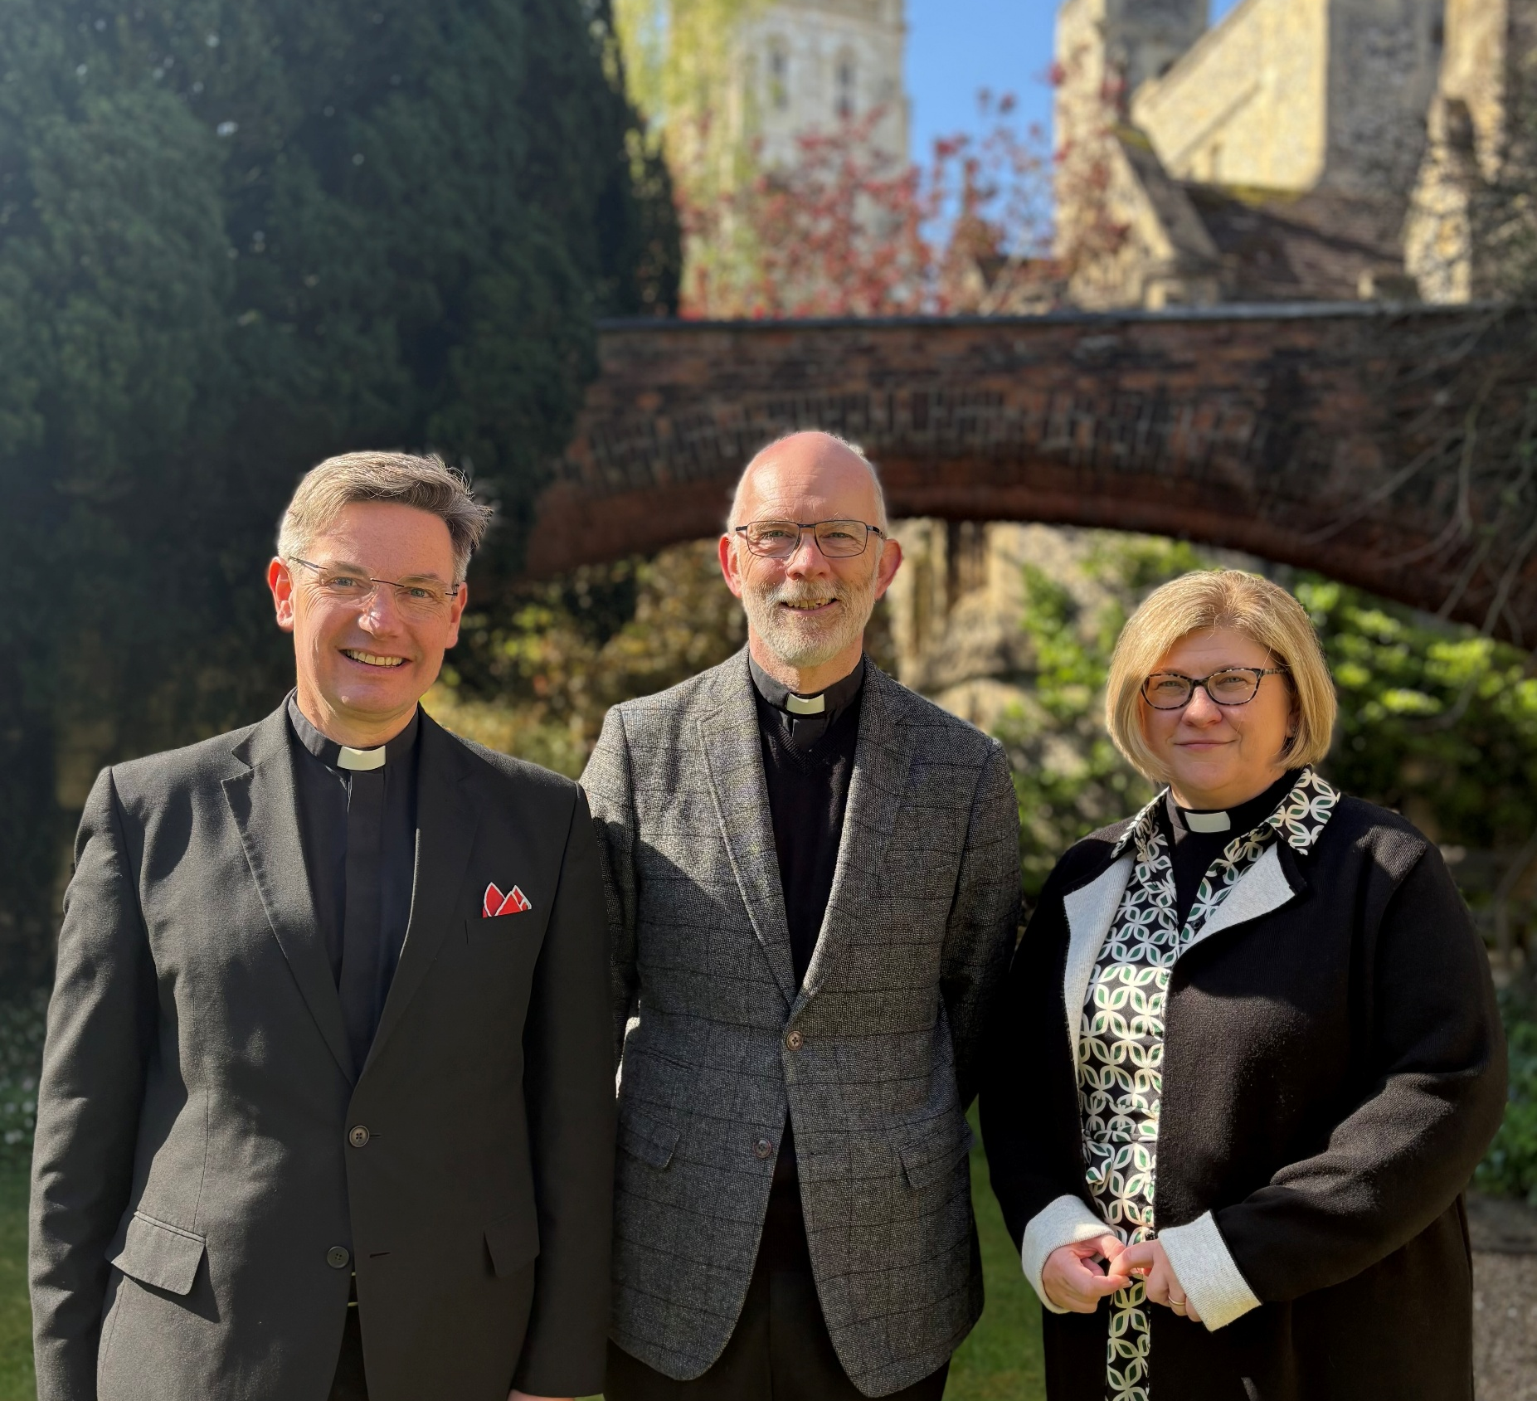
Mission Action Planning (MAP)
Notes:
--- This slide references information from the following file: https://canterburydiocesan.sharepoint.com/sites/StrategyBlueprint/_layouts/15/Doc.aspx?sourcedoc=%7BCB9CB7FE-97C2-48FD-BABA-44D0C3403F9F%7D&file=Deanery%20Roadshow%20Agenda%20full.docx&action=default&mobileredirect=true&DefaultItemOpen=1 19.30 Noticeboard - information and signposting · Finance (video) – 5 mins · Acts 435 (video and notice) – 5 mins · Net Zero Carbon (video) – 5 mins

Slide 9
Safeguarding
Notes:
--- This slide references information from the following file: https://canterburydiocesan.sharepoint.com/sites/StrategyBlueprint/_layouts/15/Doc.aspx?sourcedoc=%7BCB9CB7FE-97C2-48FD-BABA-44D0C3403F9F%7D&file=Deanery%20Roadshow%20Agenda%20full.docx&action=default&mobileredirect=true&DefaultItemOpen=1 Finance video

Slide 10
Safeguarding is Everyone’s Responsibility

Slide 11
Remember why safeguarding is important

Slide 12
National Safeguarding Standards

Slide 13
Helpful tools: Parish Hub and Dashboard

Slide 14
Parish Hubs and Dashboards Deanery Completion Progress

Slide 15
Helpful Tools NSS Audit Tool Evidence suggestions

Slide 16
Safeguarding is Everyone’s Responsibility

Slide 17
Workshops
Children, Young People and Education: Welcoming the ‘Quiet Revival’
Growing Giving and Generosity
Leading your church into growth
Notes:
--- This slide references information from the following file: https://canterburydiocesan.sharepoint.com/sites/StrategyBlueprint/_layouts/15/Doc.aspx?sourcedoc=%7BCB9CB7FE-97C2-48FD-BABA-44D0C3403F9F%7D&file=Deanery%20Roadshow%20Agenda%20full.docx&action=default&mobileredirect=true&DefaultItemOpen=1 Generous Giving & Parish Support

Slide 18
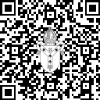
Good news stories
Sign up to our Media and Engagement Deanery Drop-Ins:
click.canterburydiocese.org/MandE-drop-ins
Notes:
--- This slide references information from the following file: https://canterburydiocesan.sharepoint.com/sites/StrategyBlueprint/_layouts/15/Doc.aspx?sourcedoc=%7BCB9CB7FE-97C2-48FD-BABA-44D0C3403F9F%7D&file=Deanery%20Roadshow%20Agenda%20full.docx&action=default&mobileredirect=true&DefaultItemOpen=1 Generous Giving & Parish Support

Slide 19
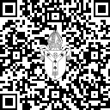
Access roadshow resources
You can access the resources from our Deanery Roadshows by visiting:
click.canterburydiocese.org/roadshows2025
Or scan this QR code:
Notes:
--- This slide references information from the following file: https://canterburydiocesan.sharepoint.com/sites/StrategyBlueprint/_layouts/15/Doc.aspx?sourcedoc=%7BCB9CB7FE-97C2-48FD-BABA-44D0C3403F9F%7D&file=Deanery%20Roadshow%20Agenda%20full.docx&action=default&mobileredirect=true&DefaultItemOpen=1 Generous Giving & Parish Support

